Slide 1

You are what you eat
Who you are is how you write ?

Slide 2
The Challenge
Can we predict personality from text alone?
Without context

Slide 3
Personality Prediction A text inference to predict type personalities

Slide 4
Let’s dive in

Slide 5
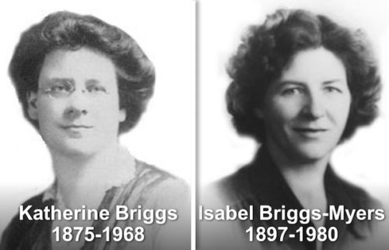
MBTI personality test
Introduction
MBTI or Myer-Briggs Type Indicator
Developed by Katherine Cook Briggs & Isabel Briggs Myers in 1940s'
Based on Carl G Jung’s Theory of Psychological Types
Produce 4 type dichotomies to develop
16 personality types

Slide 6
Type Dichotomies
Introduction
Extroversion
vs
Introversion
Sensing
vs
IntuitioN
Thinking
vs
Feeling
Judging
vs
Perceiving
Where they prefer to focus their attention and get energy
The way they prefer to take in information
The way they prefer to make decision
How they deal with the outer world
Notes:
E – perfers talking and working out ideas by talking
I – communicate in wriing and reflect ideas
S – realities focus on real and actual
N – possibilities. focus patterns, meaning,
T – analytical. Solve problem with logic
F – empathic, personal values
J – lifestyle systematic
P – flexible, spontaneous

Slide 7
Putting them together

Slide 8
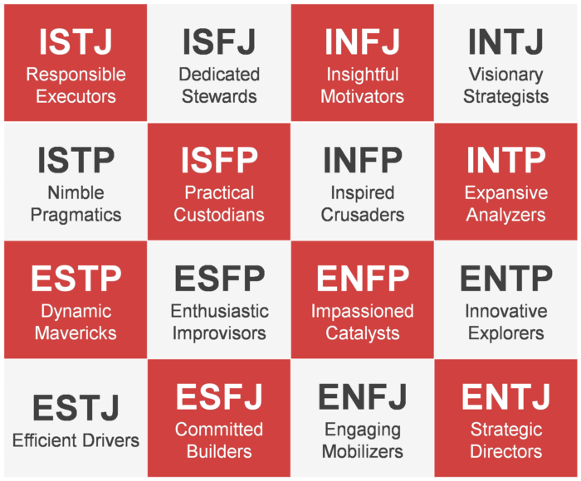
Personality Types
Introduction
Notes:
introvert people prefer messages presented from the perspective of an introvert individual. If the personality of a user can be predicted from their social media profile, online marketing among other applications can use it to personalize their messages and their presentation
quality of interactions with them as a service provider?

Slide 9
Reacting to homework…

Slide 10
Introduction
ENFJ: If we all work together, we can finished together !
ENTJ: Homework’s done. Now, to do important things.
ESFP: What homework?
ESFJ: Hmm…maybe someone else needs help
ESTJ: No such thing as a lot of homework. I worked ahead.
ESTP: Homework is for losers.
ENFP: my books are too sad
ENTP: …but I have better things to do.”
INFP: I want to do the creative analysis parts
INTP: …but I just don’t want to.”
INFJ: *looks at homework* *turns on introspective music* *goes on Tumblr*
INTJ: I’ll do the homework if it helps me in the long run…
ISFP: *plays with pencil* *draws all over paper*
ISFJ: If I do my homework, my teacher will know I respect them.
ISTP: Homework isn’t important…well, maybe that one part
ISTJ: *quietly finishes homework*
That’s the Majority
That’s Me

Slide 11

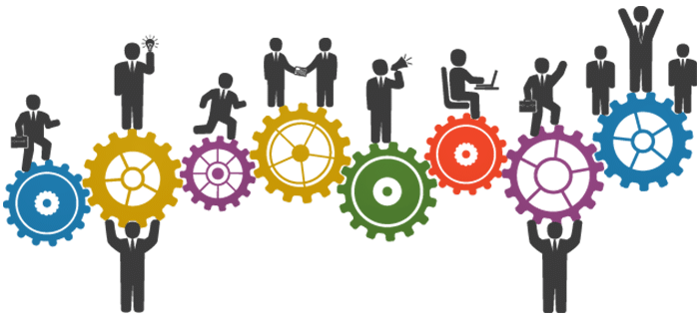
Uses
Introduction
Personal Understanding
Career
Relationships
Organization Development
Team building
Communication
Leadership
Business Analysis
Customer profiling
Business relationship
Notes:
introvert people prefer messages presented from the perspective of an introvert individual. If the personality of a user can be predicted from their social media profile, online marketing among other applications can use it to personalize their messages and their presentation
quality of interactions with them as a service provider?

Slide 12
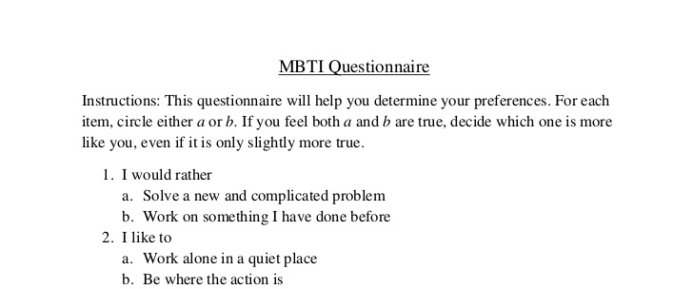
Limitation of MBTI Test
Introduction
Understanding of the question
Answer according to what he/she likes to be
Answer according how it should be
Hypothetical vs reality

Slide 13
Let’s get started…

Slide 14





Work Process
Work Process
Data Cleaning
Transforming users' posts into appropriate format
Exploration
Visual and data representation relationship between posts and users’ personalities
Data Collection
A collection of posts from over 8,000 users
Pre-Processing
Deriving useful information by means of NLP for downstream analytics
Predictive Modelling
Classify the personalities and solving with two different approaches

Slide 15
Data set
Data Collection
Type | Posts
INFJ | 'http://www.youtube.com/watch?v=qsXHcwe3krw|||http://41.media.tumblr.com/tumblr_lfouy03PMA1qa1rooo1_500.jpg|||enfp and intj moments
ENTP | 'I'm finding the lack of me in these posts very alarming.|||Sex can be boring if it's in the same position often. For example me and my girlfriend are
INTP | 'Good one _____ https://www.youtube.com/watch?v=fHiGbolFFGw|||Of course, to which I say I know; that's my blessing and my curse.|||
INTJ | 'Dear INTP, I enjoyed our conversation the other day. Esoteric gabbing about the nature of the universe and the idea that every rule and social
ENTJ | 'You're fired.|||That's another silly misconception. That approaching is logically is going to be the key to unlocking whatever it is you think you
Source
Taken Kaggle.com
Original data from personalitycafe.com forum
Data Info
8645 Users and their types
Over 400,000 post entries
Content
social media, images, videos,

Slide 16
The approach

Slide 17
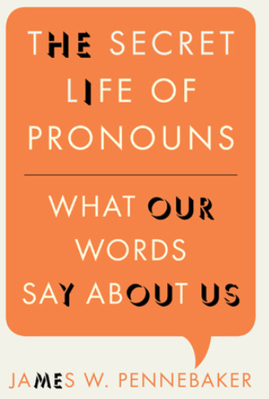
Feature Extraction
Pre-processing
Libraries
NLTK and Textblob
Tokenization
Word count. Count Vectorization
Word frequency. TFIDF transformation
Base form of a word. Lemmatization
Pronoun Extractions
Conjunction / Coordinating (e.g. and, or, but)
Determiner (e.g. the, a, these)
Pronouns (e.g. I, you, me, they)
Verbs (e.g. action words)
Perform Sentiment Analysis
Polarity (positivity / negativity)
Subjectivity (subjective / objective)

Slide 18
Let’s explore

Slide 19
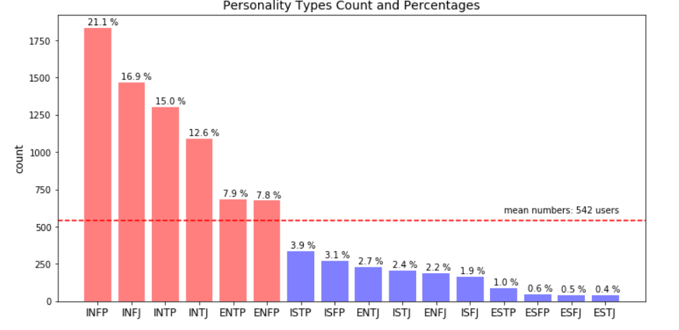
Personality types
Exploration
Approx. 80% above the mean value

Slide 20
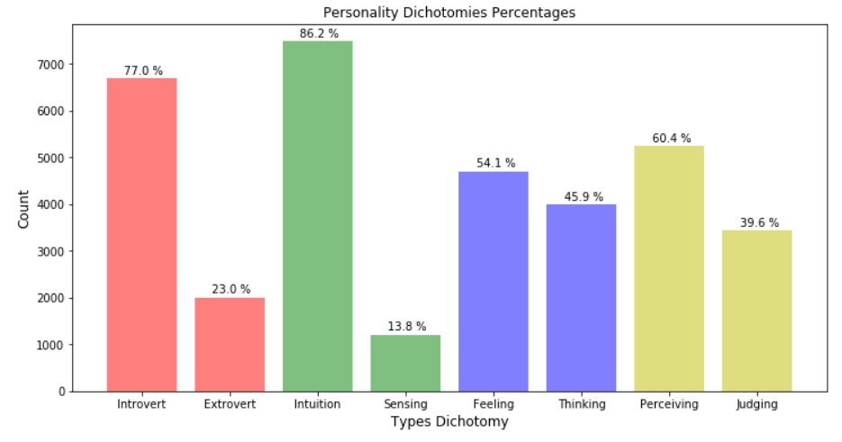
Type Dichotomies
Exploration
Imbalance ratio

Slide 21
Modeling

Slide 22
Models & Target
Predictive modeling
Classification Models
Logistic Regression
Random Forest
Naïve Bayes (Gaussian, Multinomial, Bernoulli)
K-Nearest Neighbor
Target prediction
16 personality types

Slide 23
Prediction Approach
Predictive modeling
Multi-class approach
Set numerical label to the personality type from 0 to 15
e.g. ENFJ = 0, ENFP = 1, … ISTP = 15
Binary approach
Predict each type dichotomy
Match the 4 outcomes
Type | Actual |  |  |  | Prediction |  |  |  | Correct
 | E or I | S or N | T or F | J or P | E or I | S or N | T or F | J or P
INFJ | 0 | 0 | 0 | 1 | 0 | 0 | 1 | 0 | No
ENTP | 1 | 0 | 1 | 0 | 1 | 0 | 1 | 0 | Yes
INTP | 0 | 0 | 1 | 0 | 0 | 0 | 1 | 0 | Yes

Slide 24
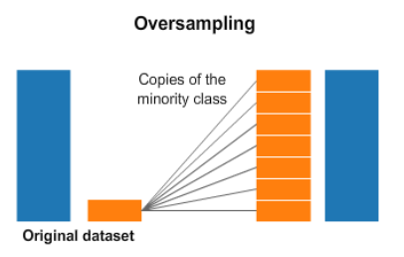
Handling Imbalance Data
Pre-processing
Library
- SMOTE (Synthetic Minority Over-sampling Technique).
Technique
Adding copies of minority classes.
Resample so that we can have exact same observation in both train and test sets.

Slide 25
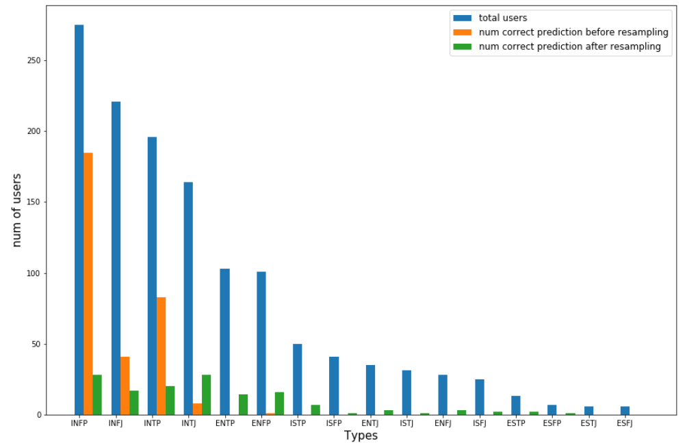
Results by Personality Type
Predictive Modeling
Baseline : 21% (based on majority)
Accuracy before resampling : 24.5%
Accuracy after resampling : 9.5%
Before resampling:
Model predict towards the majority count
After resampling:
Though Accuracy reduced after resampling
More data points are picked up

Slide 26
Results by Type Dichotomy
Predictive Modeling
Overall Accuracy : 14%
 | Recall Score | Precision Score
Extroversion - Introversion | 20% | 28%
Sensing – Intuition | 13% | 25%
Thinking – Feeling | 45% | 47%
Judging - Perceiving | 57% | 61%

Slide 27
Can we predict personality from text alone without context?
Not really

Slide 28
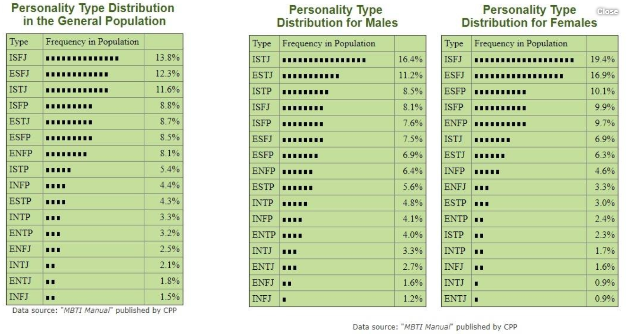
Moving forward
Concluding
Topic
Demographic details
Accuracy / recency of dataset
Culture and level of language of users
Utilize other classification models and deep learning

Slide 29
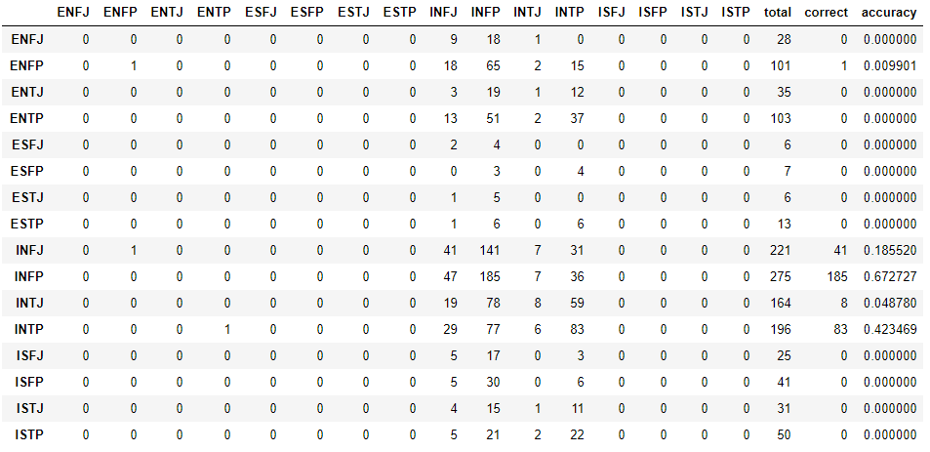
Initial Result
Predictive Modeling
Confusion Matrix

Slide 30
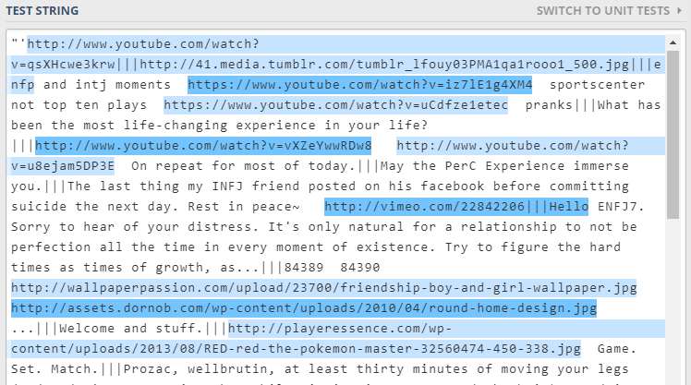
Data Cleaning
Pre-processing
With Regex
URLs
Digits
Punctuations
Character case
Separate the posts into entries
Post from one user

Slide 31
MBTI Today
Introduction
Over 80 years of research.
Most widely used instrument for understanding personality.
More than two million assessment administered in US alone
Translated to over 30 languages.
Notes:
introvert people prefer messages presented from the perspective of an introvert individual. If the personality of a user can be predicted from their social media profile, online marketing among other applications can use it to personalize their messages and their presentation
quality of interactions with them as a service provider?

Slide 32
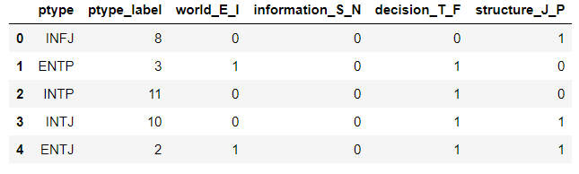
Target Formulation
Pre-processing
Target Formulation
Label Encoding for Multi-class targets of 16 personality types.
Dummify binary targets of 4 type dichotomies
Label Encoding
Dummify

Slide 33
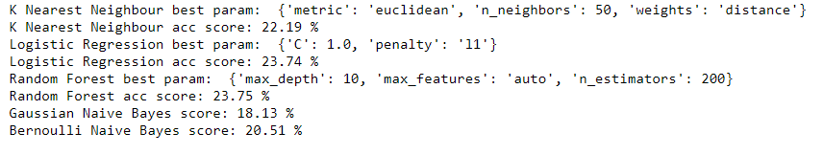
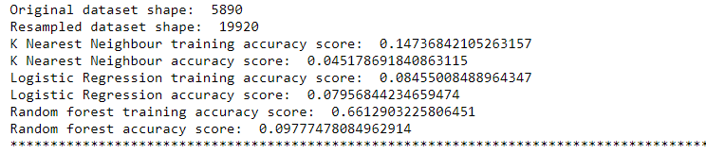
Results Comparison
Predictive Modeling
Prediction on Original Data
Prediction on Oversampling Data from Cross Val

